Slide 1
Stat 495r – Presenting Data
Week 2
Fall 2020

Slide 2
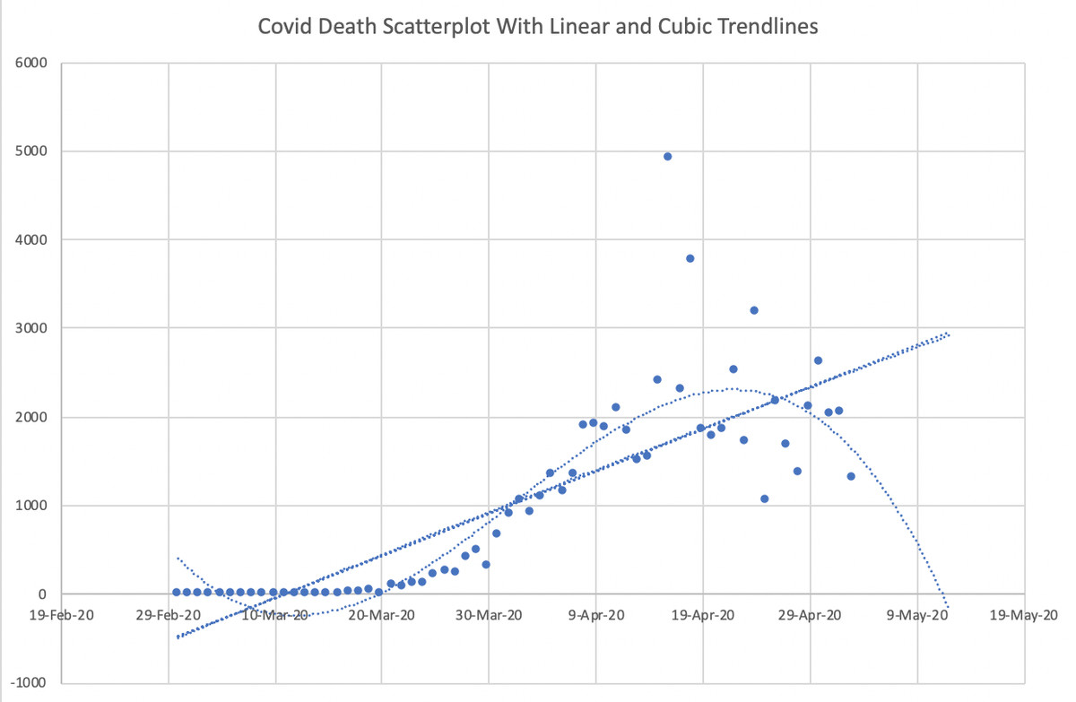
Data Viz #1
Notes:
https://www.vox.com/2020/5/8/21250641/kevin-hassett-cubic-model-smoothing
former Council of Economic Advisers Chair Kevin Hassett, and the Post reported that “people with knowledge of that model say it shows deaths dropping precipitously in May — and essentially going to zero by May 15.”

Slide 3
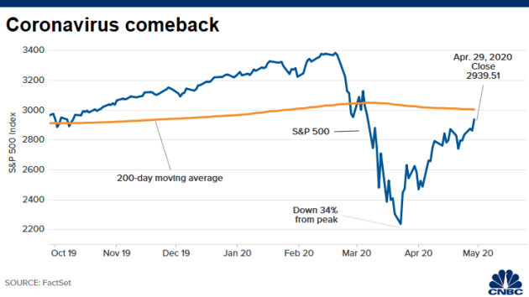
Data Viz #2

Slide 4
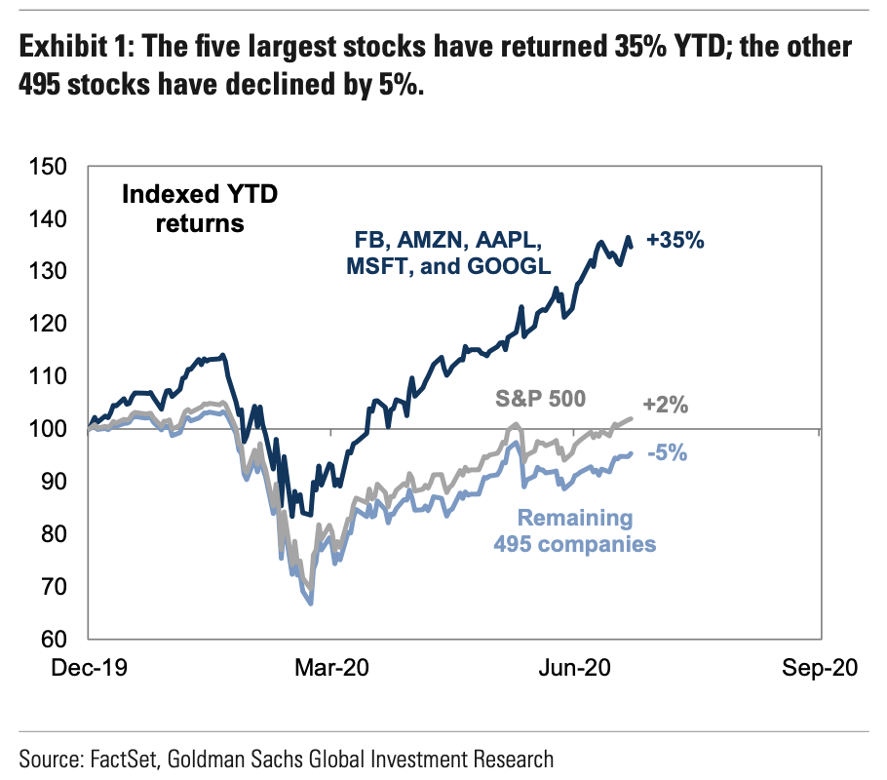
Data Viz #3
Notes:
If you are wondering why the stock market is doing well… it’s really only 5 companies
Since the Jazz are out. Next week we are only looking at NBA visuals
Please DM me visuals you see

Slide 5
Book Club Time
Notes:
Who has the book?
How do audiences differ?
What did you get out of the readings?
How do your professors ”Show the Data”?
How do TV shows “Show the Data”?
What classes have you had where you have had to make big presentations?

Slide 6






Choose a Company
Notes:
I want to get out of PowerPoint quickly. But we probably have one more day of it.

Slide 7
Terminology

Slide 8
Chart Elements

Slide 9
Chart Elements
Major Gridlines
Ticks
Plot Area
Data Labels
Axis
Ticks
Legend

Slide 10
The Power 6 Types of Charts
Table
Simple Text
 | A | B | C
Rev | $5 | $10 | $15
Cost | $4 | $3 | $7
Tot | $1 | $7 | $8
91%
Notes:
Charts vs Graph

Slide 11
The Bar Chart

Slide 12
A Default Bar Chart in PowerPoint
Notes:
Notice the gaps between bars

Slide 13
A Stacked Bar Chart in PowerPoint

Slide 14
Another Stacked Bar Chart in PowerPoint

Slide 15
A Special Stacked Bar Chart in PowerPoint

Slide 16
Another Default Bar Chart in PowerPoint
Notes:
Notice the y-axis is now in reverse order
These all have stacked equivilants

Slide 17
The Line Chart

Slide 18
Default Line Chart in PowerPoint
Notes:
You can add points

Slide 19
Another Default Line Chart in PowerPoint

Slide 20
Another Default Line Chart in PowerPoint

Slide 21
The Scatterplot

Slide 22
Default Scatter Plot

Slide 23
Default Bubbles

Slide 24
Tables

Slide 25
Default Tables
A | B | C
1 | 3 | 4
4 | 5 | 6
22 | 4 | 5
5 | 3 | 1
A | B | C
1 | 3 | 4
4 | 5 | 6
22 | 4 | 5
5 | 3 | 1

Slide 26
Simple Text

Slide 27
Text Boxes
91%
But you can change the text colors
Add formatting where needed

Slide 28
Pie Charts

Slide 29
Default Pie Chart

Slide 30
A Donut Chart is just a Pie Chart

Slide 31
Combinations

Slide 32
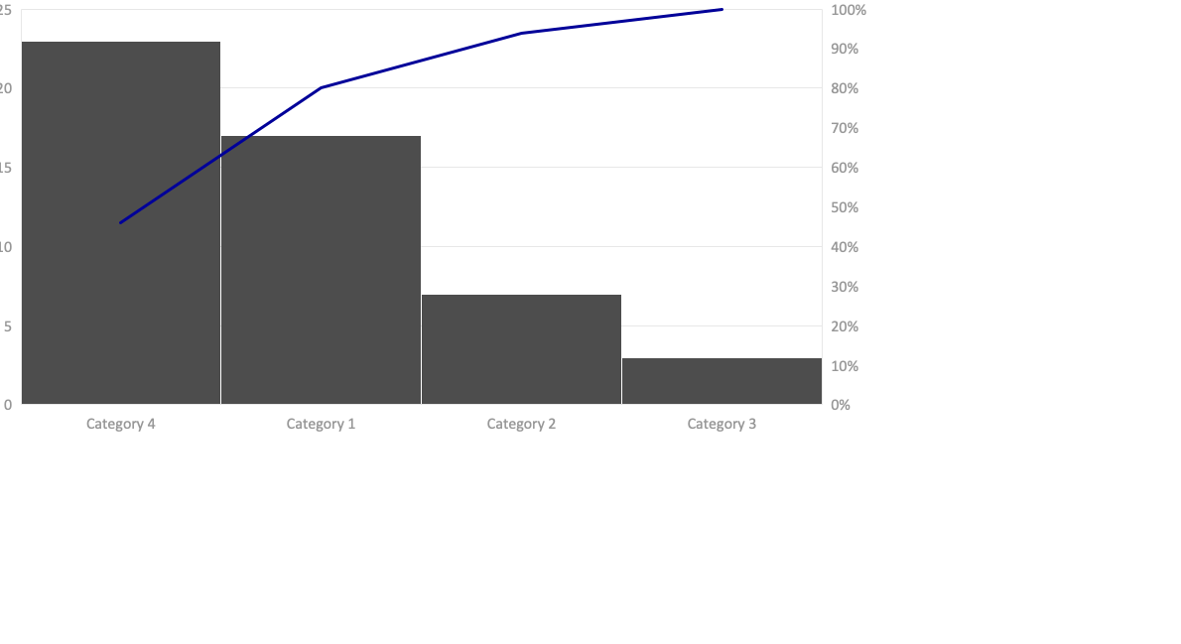
Bar Chart with Cumulative Line

Slide 33
Pie Chart with Stack Bar Breakout

Slide 34
Bar Chart with Line Segments for Error Bars

Slide 35
Bar Chart with Trendline

Slide 36
Charts NOT to use

Slide 37
Distribution of Charts Types

Slide 38
Removing Chart Junk

Slide 39

“I prefer quality over flash – that’s why I refuse to write my name in cursive”

Slide 40
Example Decluttering
 | Overall Win Rate | My Teams Win Rate
2018 - Q4 | 44% | 60%
2019 - Q1 | 42% | 56%
2019 - Q2 | 44% | 48%
2019 - Q3 | 41% | 58%
 | Overall Win Rate | My Teams Win Rate
2018 - Q4 | 44% | 60%
2019 - Q1 | 42% | 56%
2019 - Q2 | 44% | 48%
2019 - Q3 | 41% | 58%

Slide 41
Example Decluttering

Slide 42
Example Decluttering
Win Rate by Quarter
Projects with my team have win rates 15% higher

Slide 43
Projects with our team are much more likely to close
Win Rates by Quarter
Projects with our team win about 15% above projects without our team
Win rate for all projects without our team
Win rate for all projects WITH our team
Q4 | Q1 | Q2 | Q3
2018 | 2019
Source: Salesforce Datamart
Notes:
Removing chart junk
Bar gaps
Locking y-axis
Reversing axis
Manual waterfalls
Increasing points and line widths
Changing colors
Adding data labels
Formatting data labels
Formatting axis text
Moving legend

Slide 44
Activity

Slide 45
The Pie Chart – In Depth!

Slide 46
Hate on Pie Charts
“the only worse design than a pie chart is several of them, for then the viewer is asked to compare quantities located in spatial disarray both within and between pies” – Edward Tufte
“Save the pie charts for dessert” – Stephen Few
”Pie charts are evil” – Cole Nussbaumer Knaflic

Slide 47
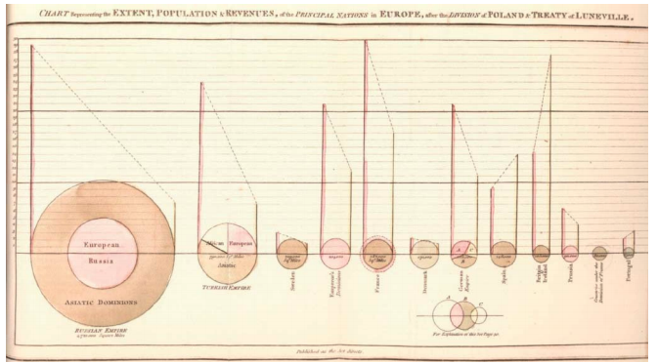
The First Pie Chart Documented

Slide 48
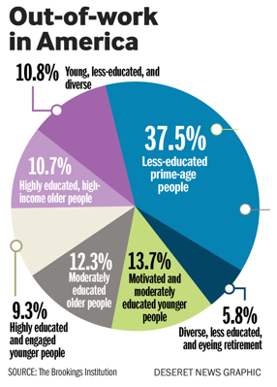
Notes:
Color
Deliberately hiding data
Being a Pie Chart in general
Orientation
Font
Mixed labels
Math

Slide 49
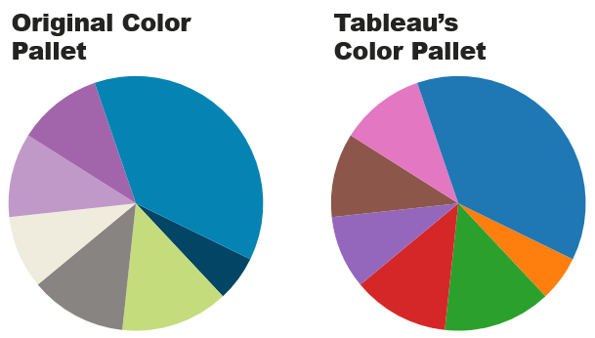
Color

Slide 50
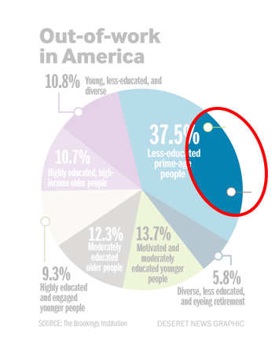
Deliberately Hiding Data

Slide 51
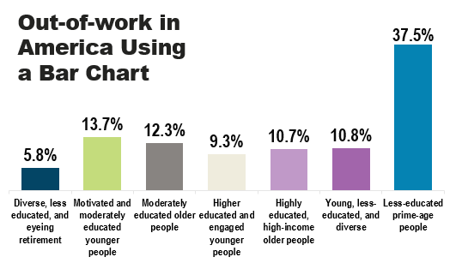
Being a Pie Chart

Slide 52
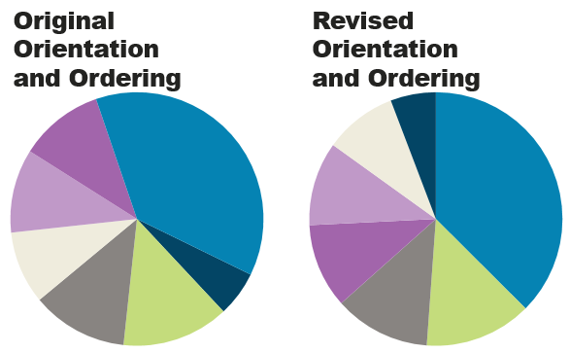
Ordering, Position and Count of Slices

Slide 53
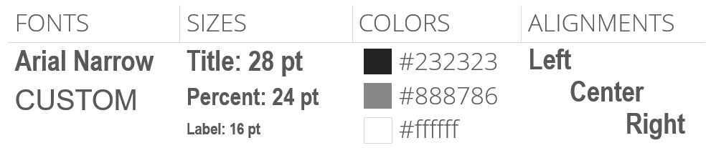
Fonts

Slide 54
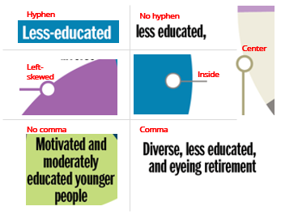
Labels

Slide 55
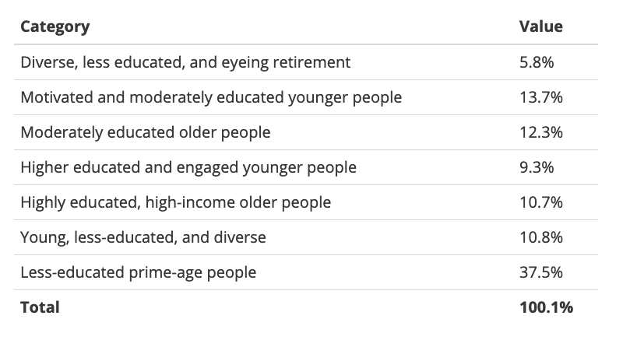
Decimal Places and Math

Slide 56
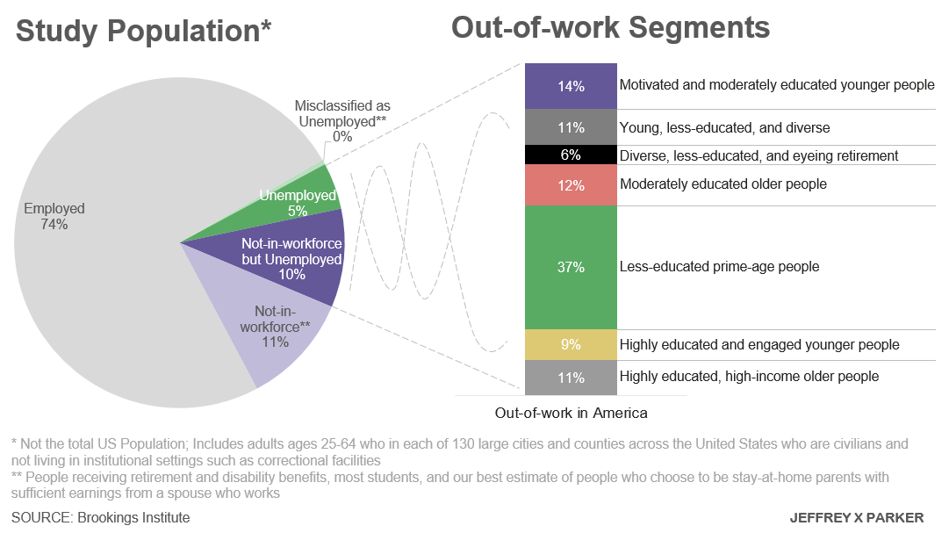
Decimal Places and Math
Notes:
https://www.brookings.edu/research/meet-the-out-of-work/

Slide 57

Pie Charts

Slide 58
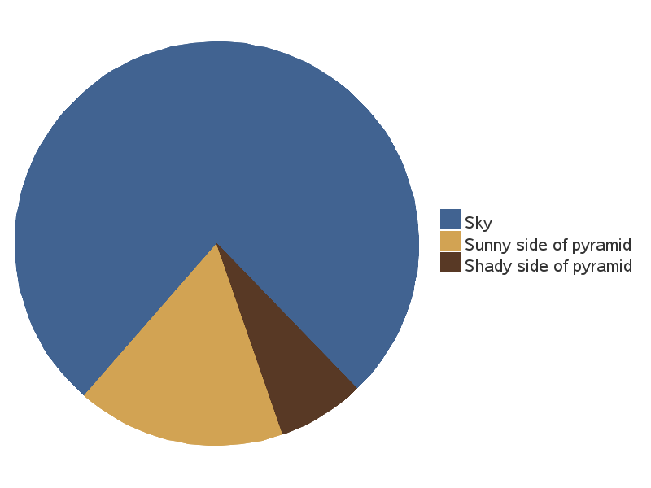

Slide 59
Pie Chart Theory
19%
Purchase with Add-on
Show the PART-TO-WHOLE relationship especially with few groups and exact values not imporant
Stylize with text and icons

Slide 60


Pie Chart Theory
Order Most to Least Clockwise
Most Important Pieces at 12 o’clock
Random ordering, with and positioning

Slide 61
Pie Chart Theory
The sum of the parts equals 100%
The sum of the parts does not equal 100%
Tip: Always have the data labels be the “value” not the ”percent”
Notes:
Is

Slide 62
Pie Chart Theory
Less than ~4 groups
More than 5 groups
Tip: Group small categories
Notes:
Is

Slide 63
Pie Chart Theory
Use bars
Use multiple pie charts
Tip: Draw in lines between categories

Slide 64

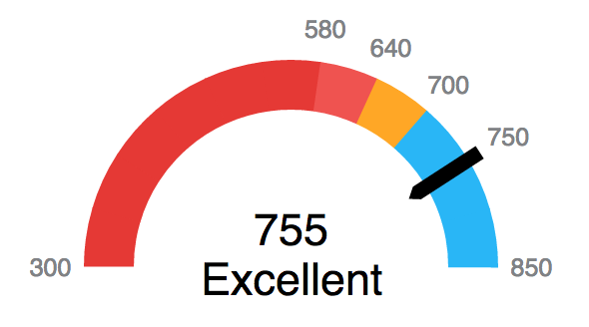
Pie Chart Theory
Make art by using polar coordinates
Use for familiar percentages or for icons (called “Harvey Balls”)
Sparingly use gauge charts
Notes:
Color art forthcoming

Slide 65
Pie Chart Theory
Use to support another chart type
Explode a slice for emphasis

Slide 66
Homework 1 – Create Journalism Visuals
Read this article: https://themargins.substack.com/p/doordash-and-pizza-arbitrage
Create a visual (maximum 1 slide) that demonstrates the pizza shop owners actions to readers and explains how he made a profit
Create a visual (maximum 1 slide) that illustrates to readers the points made in the “Food Delivery Platform Existentialism” section – outside data sources can be used, but be sure to cite

Slide 67
Homework 2 – Declutter this Visual
1. Improve this visual by decluttering it. Keep it a bar chart. Data is embedded in PowerPoint.

Slide 68
Homework 3 – Practice Making Visuals
Tier | # of Accounts | % Accounts | Revenue ($M) | % Revenue
A | 77 | 7.08% | $4.68 | 25%
A+ | 19 | 1.75% | $3.93 | 21%
B | 338 | 31.07% | $5.98 | 32%
C | 425 | 39.06% | $2.81 | 15%
D | 24 | 2.21% | $0.37 | 2%
1. Make at least 3 slides with visuals from this data that convey the story and information

Slide 69


